Slide 1



DATA 601 | Fall 2022
Lecture
01:
Introduction
Samantha Corbin

Slide 2

About me…
GIS Supervisor for the City of Baltimore
Adjunct Professor
UMBC Alumnae (2002)
Hobbies: Sports, Outdoors, Science/Fantasy
•
•
GitHub: scorbindata601/DATA601 (github.com)
Tutor: Sri Bhanu Gundu

Slide 3
Ground Rules
Schedule: 6:00 PM – 8:40, 10 minute break around 7:20
Bathroom breaks at any time, no need to ask
Do your best to be punctual (start of class, break, end of class)
Raise your hand if you have a question
Don’t apologize for asking a question or not knowing something
The only dumb question is the one not asked…
Show respect to your fellow classmates
It is acceptable for you to occasionally not participate
Tell me if you cannot hear or understand me
Slides/course material presented during class will be provided after the lecture
I value your feedback
Direct, verbal, indirect, anonymous (question/comments on your desk)
If you have questions about grades, homework or assignments please reach out to the TA.
–

Slide 4
Ground Rules (Cont…)
Please email me in advance if you are going to miss class
If you have COVID symptoms, please do not come to class, email me (I will share my screen via BB Ultra)
Discussions on HWs are more than welcome. Please feel free to discuss using the BB forum.
Code sharing, copy+paste+modify is not acceptable
First catch: 0 without explanation
Second catch: F without explanation

Slide 5
Ground Rules (Cont…)
Please submit your HWs via Blackboard
You will need to save your work as a jupyter notebook
The notebook has to be in a working condition
The grader will do “Restart the kernel and run all cells” if there is an error, they will not continue grading
The name of the file should be in the following format: Lastname_HWXY.ipynb, e.g. Corbin_HW01.ipynb
Late HWs will not be accepted (unless due to dire situations)

Slide 6
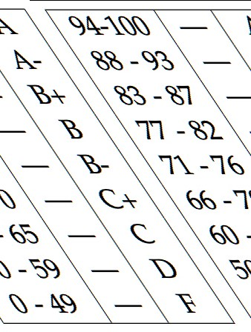
Schedule and Grading
•
Note that our syllabus and weekly schedule are
totally tentative. We
remove, add, etc.
might
speed
up,
slow
down,
•
Tentative Grading
–
–
–
–
Attendance (5 %)
4
7
2
Quizzes (9%)
Homework (56%)
Projects (30%)

Slide 7

WHAT IS DATA SCIENCE?

Slide 8
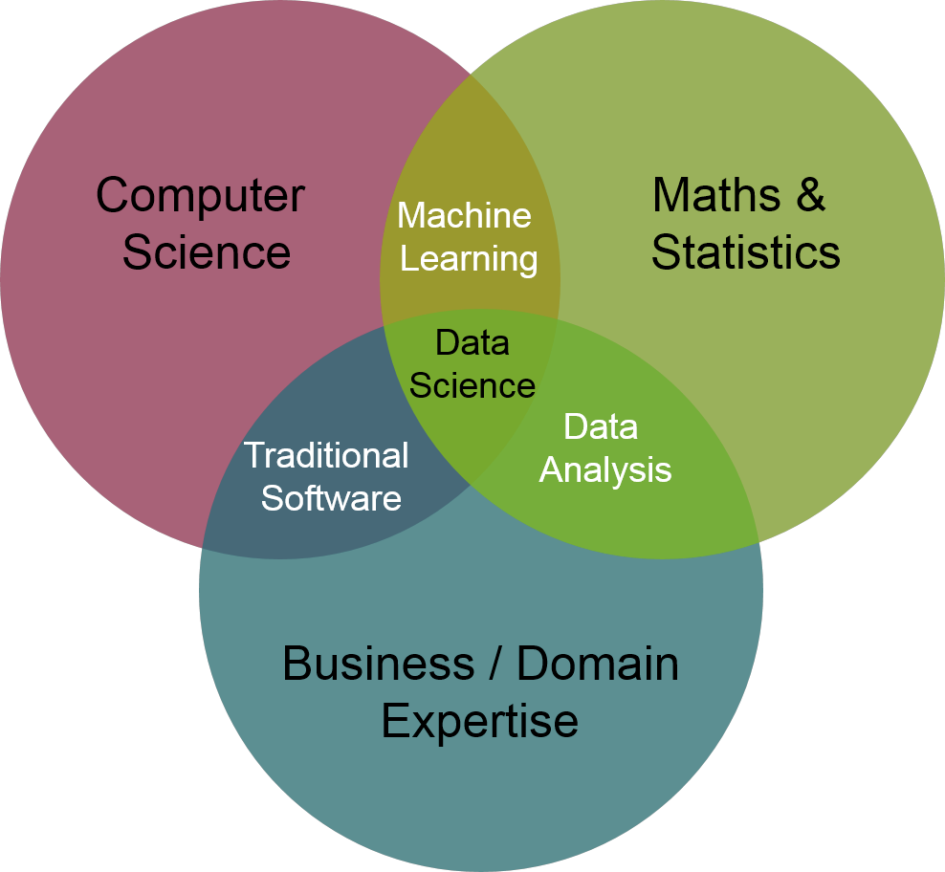
What is Data Science?

Slide 9
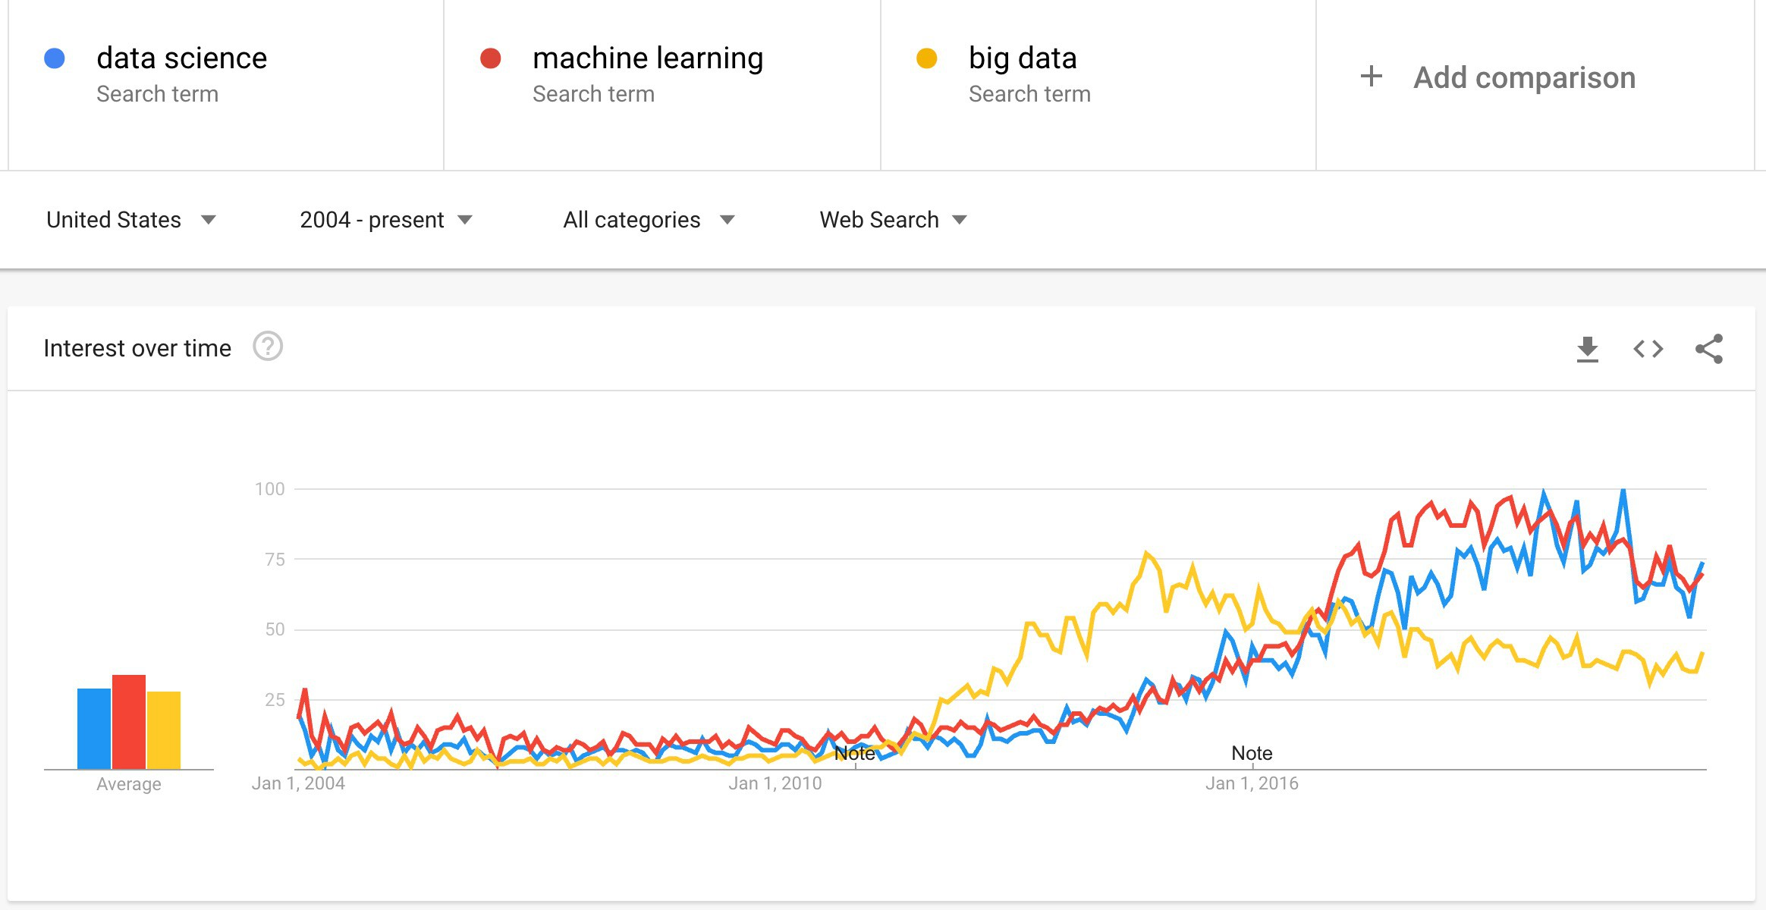
Interest on Data Science

Slide 10
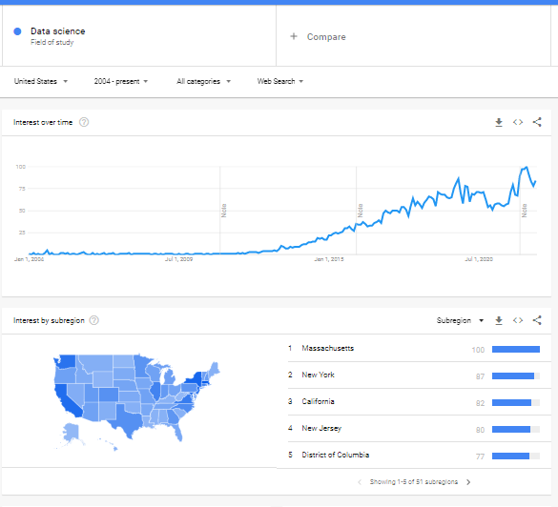
Interest on Data Science
https://trends.google.com/trends/explore?date=all&geo=US&q=%2Fm%2F0jt3_q3

Slide 11
DS is an active field with lots of jargon
There will always be something you haven't heard of
before.
Know enough to be conversant with peers
Be curious about new topics
Research concepts and labels before using them
There is a large community of data scientist who love to share their work and support new and upcoming data scientists
As with any technology field, things are always changing and it is impossible to know everything.
When in doubt or don’t the understand the code, Google it
Don’t re-invent the wheel, take advantage of free code through Github
Reference: http://www.datascienceglossary.org/

Slide 12
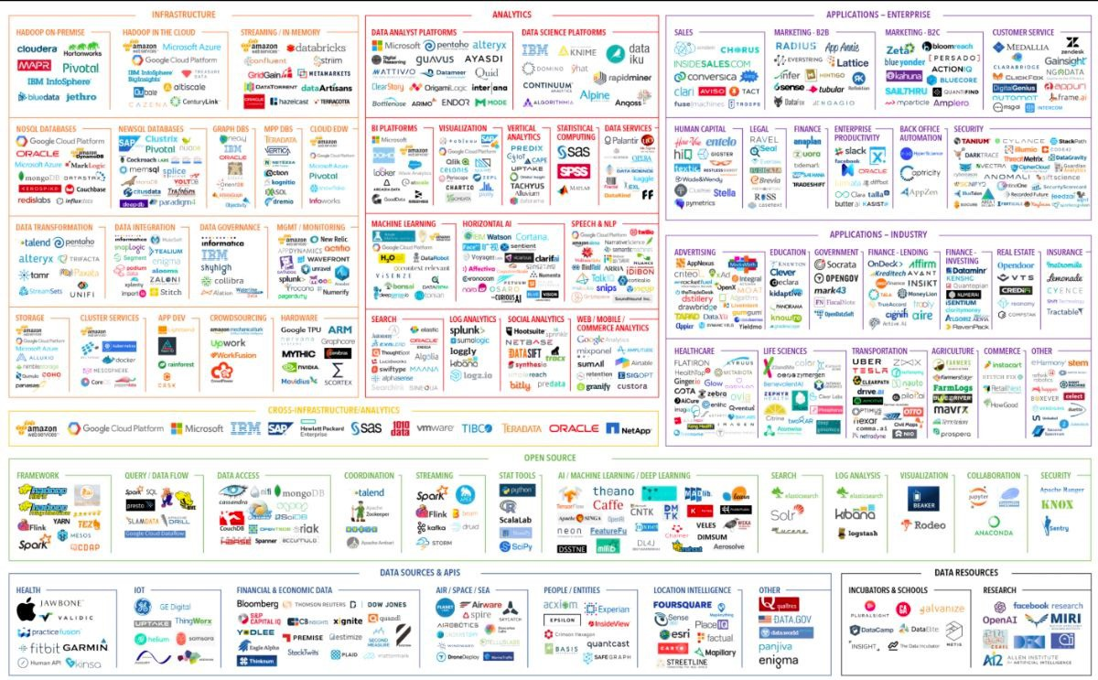
The World of DS is Huge. Don’t get lost!

Slide 13
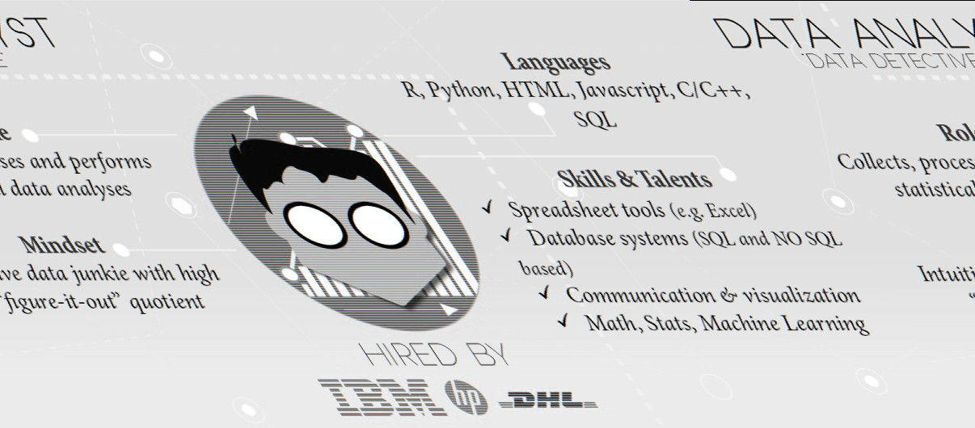
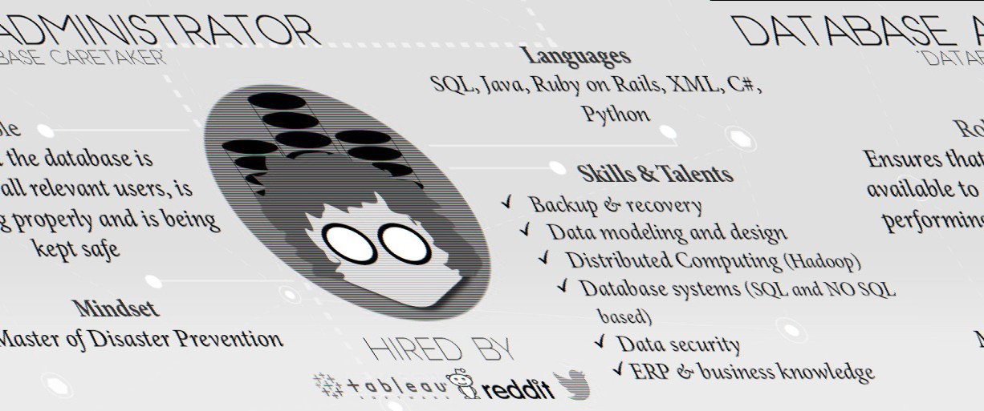
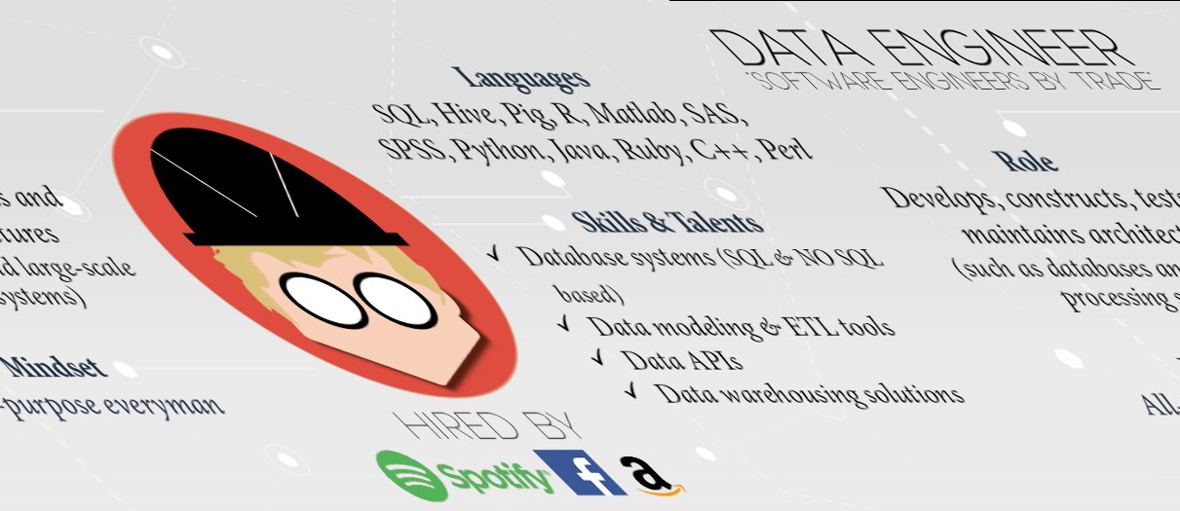
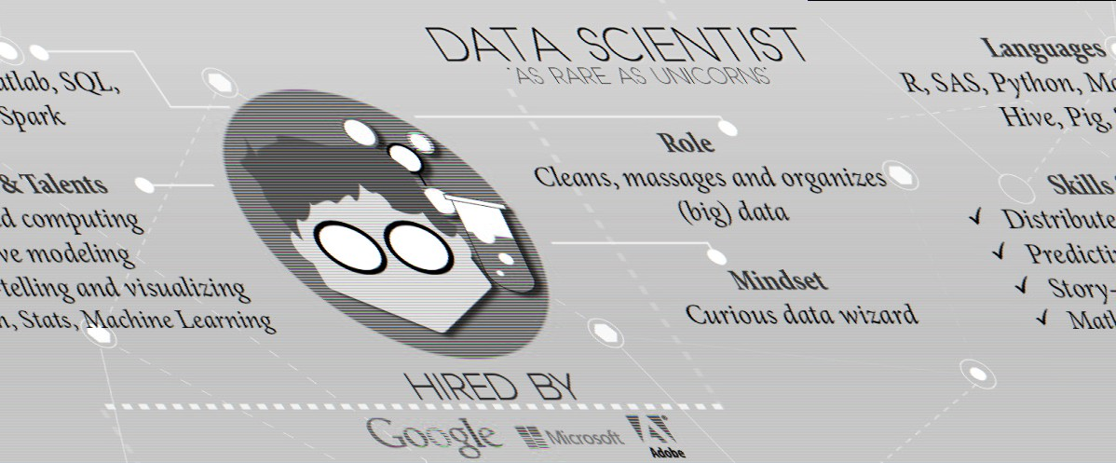
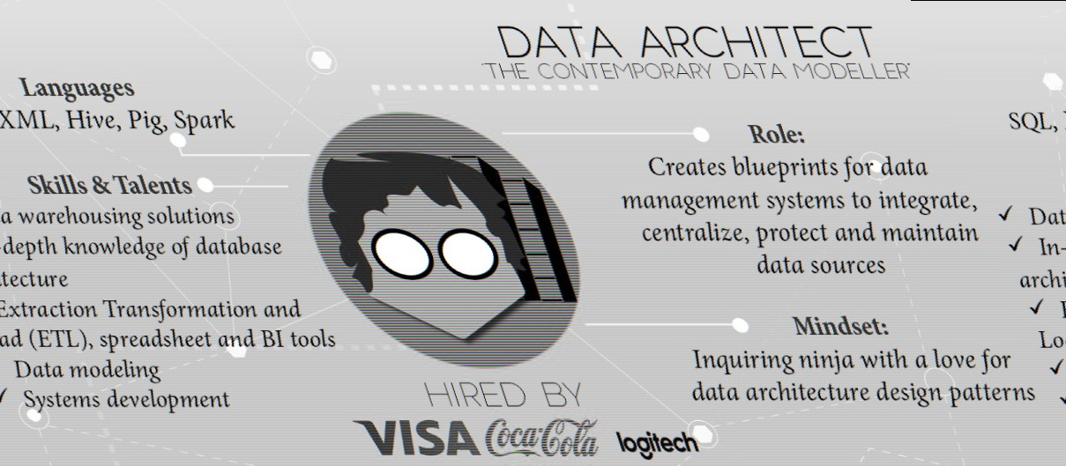
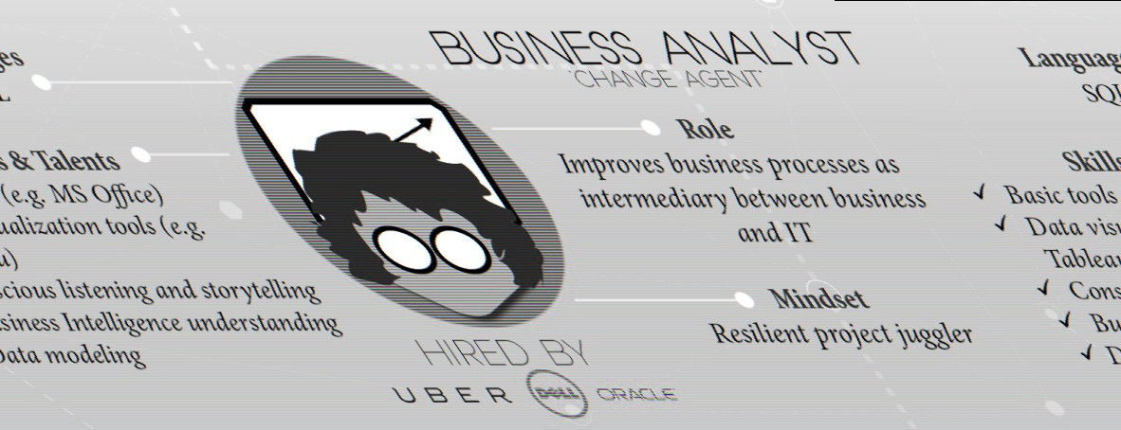
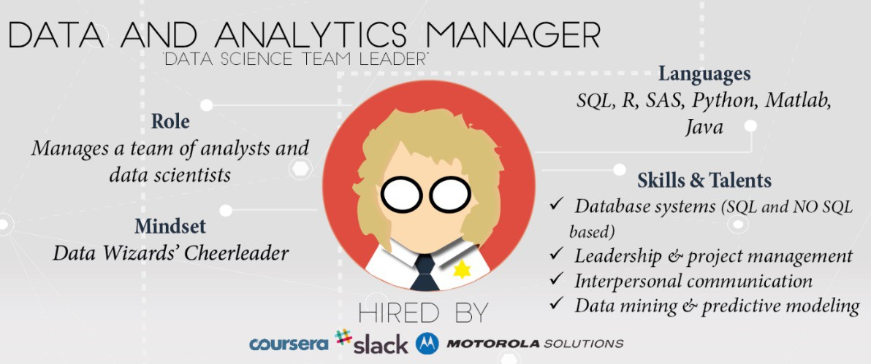
Skills and experience matter
more
than
title
and
labels
https://www.datacamp.com/community/tutorials/data-science-industry-infographic
Historical progression: data grooming, data mining, data scientist

Slide 14
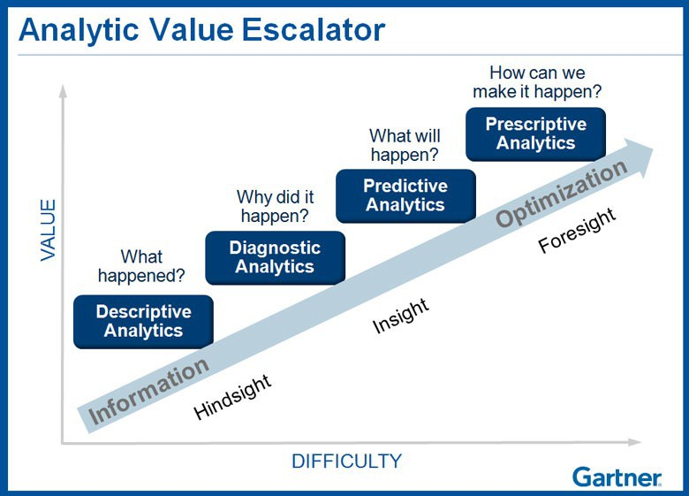
Why learn
data
science?
Explore: identify patterns
Predict: make informed guesses
Infer: quantify what you know
Motives:
•
Make money
• Employment
• Promotion
Help people
Gain new knowledge
•
•

Slide 15
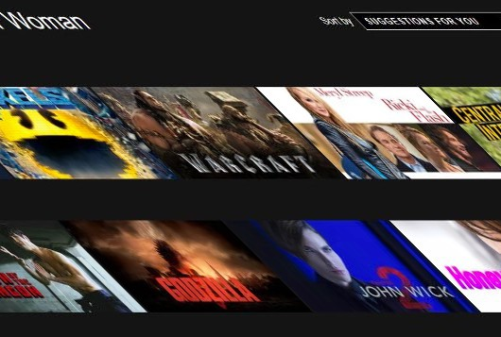
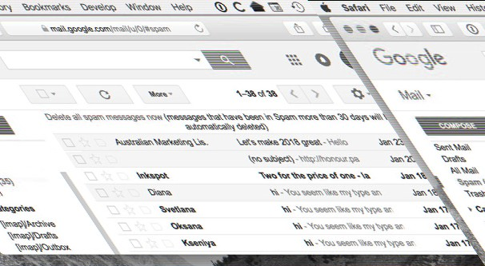
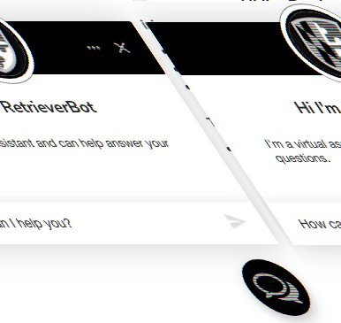
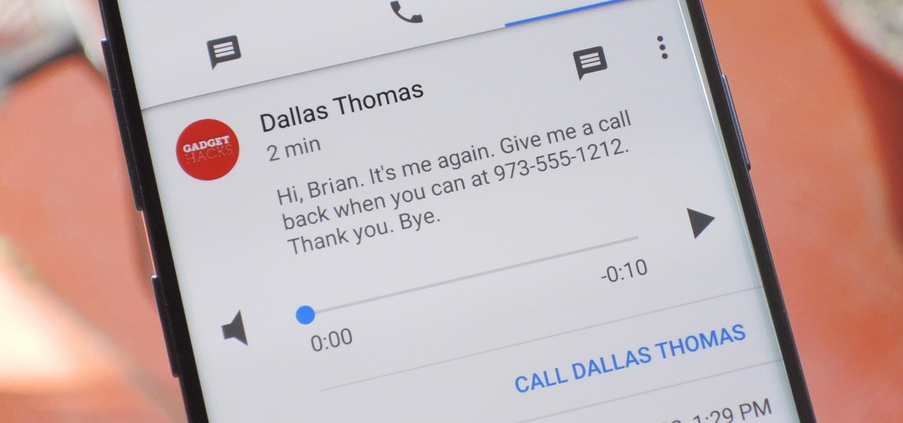
Large scale use cases with lots
Google's search engine
Bank and Credit Card fraud detection
Logistics (DHL, UPS) of fleet management
of
data
•
•
•
•
Healthcare
records
from patients
Each depends on availability of compute and data

Slide 16
Assumption in this class
•
In class we will assume you are a lone data scientist on
an
island with an internet connection.
•
This is not the typical case -- you'll have coworkers,
customers, bosses, competitors, collaborators, peers.
Example of how class ≠ real world
•
•
This class will not use competitive grading. (Imagine if it were.)
As an employee at a company, you may be competing for a bonus or promotion
--> consequence: personal and organizational politics factor into the work environment

Slide 17
Small scale use cases with not
As a business employee or bureaucrat or politician
much
data
•
•
•
•
How do I improve decision making process?
How do I evaluate the outcome of decisions?
How do I decrease the risk when faced with an opportunity?
How do I convince other stakeholders of the best course of action?
While not taking too much time, spending too much money, using the
resources I already have access to, and in a way that is convincing?

Slide 18
Logistics
Python with
•
Anaconda
– Jupyter
•
Google
Colab
•
•
Google
GitHub
Drive
or Blackboard

Slide 19

Why Jupyter + Python for Data
601?
Jupyter is useful for
•
•
•
Exploration of data (jargon: EDA = exploratory data analysis)
Documenting your activities (to enable reproducibility)
Figuring out which software is relevant, which algorithms to use,
which software libraries are useful
Visualizing results
•
And both Jupyter and Python are free!
And both are widely used!

Slide 20
Python and Jupyter do not cover every use case
•
•
For sufficiently large data sets, Jupyter and Python are not the right tool
For sufficiently complex analytics, Jupyter and Python are not the right tool
Speed and security are typically not your priority during
exploration
Knowing when to invest in switching tools is a skill
Evaluate trade-offs of flexibility and security and speed for given scale
a

Slide 21

Relevance of infrastructure to data
science
Usual explanation when replicating analysis:
1.
2.
Get this data
(Documentation)
Apply
this
transformation
to
get
result
No explanation of
–
–
–
–
software used
software versions
configurations
Implementation details
Digital archeology:
Suppose you are to diagnose why someone else's approach doesn't yield same results
Suppose they did their work 20 years ago

Slide 22
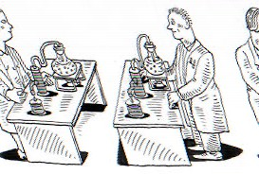
Infrastructure in data science to enable
Reproducibility and Portability
In addition to data and analysis, implementation and environment matters
1.
2.
3.
4.
5.
6.
7.
8.
Use this Operating System
Install this software Configure software this way Add these packages
Get this data in this format Run analysis against data Create plots
Generate report

Slide 23
Best practices: Version control
•
Reproducibility applies to your own attempts
other people)
(not just
•
Regardless of how you develop analytics, you'll be
creating or editing software and documents.
•
[lesson] Regardless of how you implement best practices,
avoid inventing solutions for which someone else already
provided a path.
Suggested resource:
https://try.github.io/

Slide 24
WHAT ARE WE NOT COVERING?

Slide 25
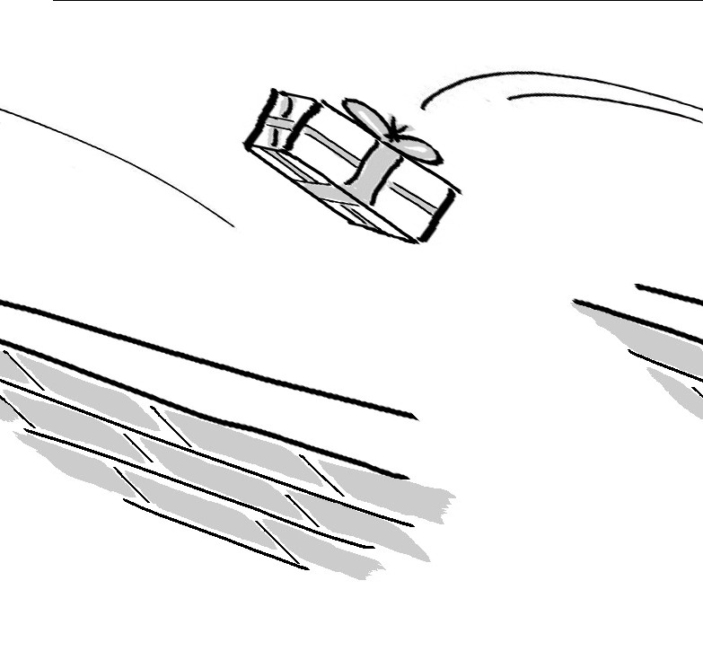
Not covered: product integration
•
There's a complex network of dependencies (i.e.
science is one component.
software engineers, managers) of which data
•
Downstream consumers of your output are likely
to be software developers who use
containers and support users.
•
This class is focused on the data science; not with
integration.
See http://dev2ops.org/2010/02/what-is-devops/

Slide 26

Not
covered:
security
This course is just an
introduction course to prepare
you for the remaining 8 classes.
Security is not covered at all.

Slide 27
SOFT SKILLS

Slide 28
DS is more than Math and
Human interaction in data science
Software
•
•
•
Discovering stakeholders
Negotiating with data owners
Customer
engagement
https://hbr.org/2017/01/the-best-data-scientists-get-out-and-talk-to-people

Slide 29
Iterating with customers
As a data scientist, you'll often be working yourself.
•
for someone other than
•
Expect under-specified requirements from customers.
Iterate.
•
Provide incomplete solutions rather than waiting until
is perfect.
the product
https://en.wikipedia.org/wiki/Minimum_viable_product

Slide 30
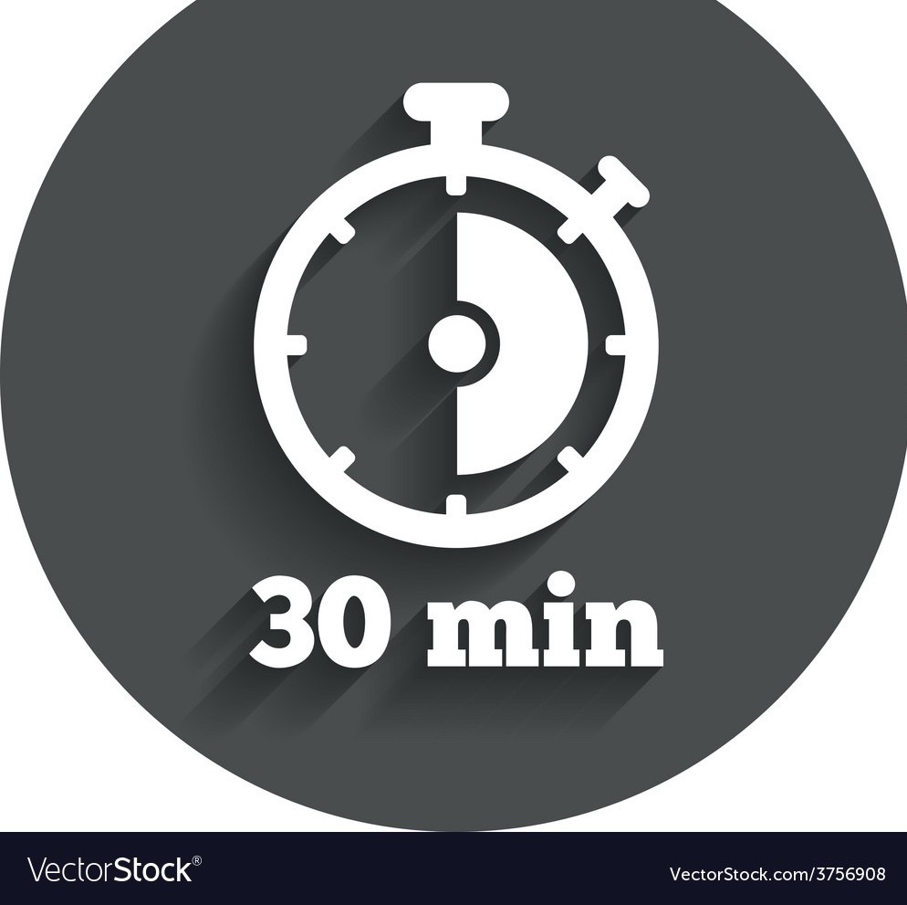
When
When
When
to
to
to
persist,
change course,
seek help
Try attacking the challenge for 30 minutes
Then seek help or do something else for a
while
https://en.wikipedia.org/wiki/Pomodoro_Technique

Slide 31
Pro-tip when seeking help
How to ask well-formed questions: https://stackoverflow.com/help/how-to-ask [Intentional sidetrack to StackOverflow.]
Ask technical questions:
•
•
Poor: "I don't understand Python dictionaries" (--> online tutorials)
Better: "When is it appropriate to use a key-value pair?"
•
•
Poor: If I submitted this assignment as is, what score would I get?
Better: I am planning to submit the attached assignment, but currently there's an error in the third cell. I've searched online but don't find any references to the error message. Can you provide guidance?

Slide 32
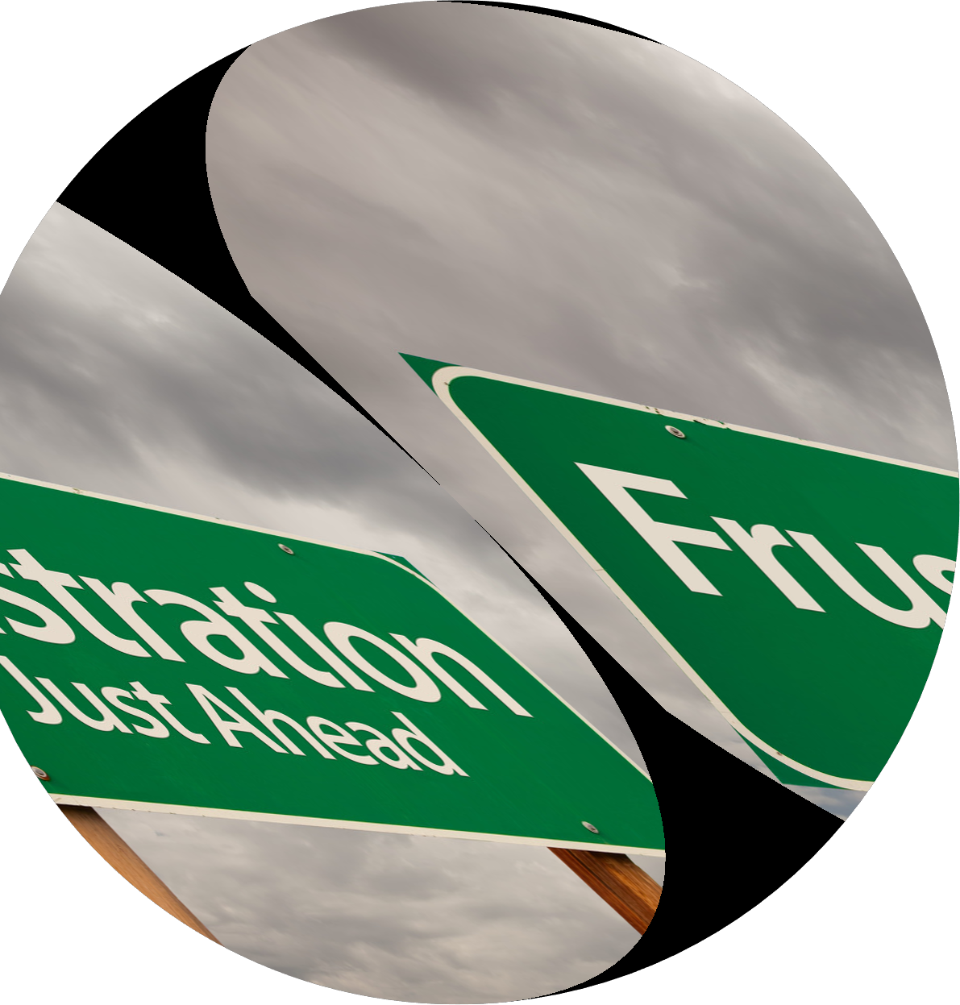
Emotions in Data Science
As a data scientist, most of your time will be spent in a desert of uncertainty, frustration, and doubt.
•
•
There will be rare short-lived
interspersed spikes of excitement and
happiness due to events like getting a new dataset, creating a new analytic, getting a new result, or being thanked by a stakeholder.
This experience is normal and does not go away.
See also the psychology of slot machines

Slide 33
Reading Suggestions
1.
2.
50 years of data science
A Very Short History Of Data Science
Action: Read, write, tell
News and blogs
https://www.kdnuggets.com/
https://news.ycombinator.com/
https://hackernoon.com/ https://www.reddit.com/r/datascience/ https://dataelixir.com/newsletters/ https://insidebigdata.com/ https://ai.googleblog.com/

Slide 34
Some Online Resources
•
Meetups
–
–
–
https://www.meetup.com/topics/data-science/
https://www.meetup.com/DataWorks/
https://www.meetup.com/Statistical-Seminars-DC/
•
Others
–
–
Salaries: https://www.burtchworks.com/category/salary/
A weekly social data project in R: https://github.com/rfordatascience/tidytuesday
•
Datasets to work with
–
–
–
https://datasetsearch.research.google.com/
https://datacatalog.worldbank.org/
https://opendata.maryland.gov/

